Slide 1


HTML Foundation Framework: Background Colors
This presentation explores background colors in the HTML Foundation framework. We'll cover their purpose, application, and best practices.
By Riyaz Ahmed
ra
Notes:
1

Slide 2

What are background colors?
1
Coloring Elements
2
Improving Readability
They add visual appeal and enhance the user interface by defining the visual backdrop of elements.
Background colors improve readability and contrast, making text easier to read.
3
Setting Mood
4
Creating Visual Hierarchy
Background colors can subtly evoke specific emotions and moods, influencing the user's perception.
They help establish visual hierarchy, guiding the user's eye and highlighting important content.
Notes:
2

Slide 3
Using bg-primary and bg-secondary
bg-primary
bg-secondary
A standard, default background color usually associated with the brand's main color. It's often used for key elements like headers and buttons.
A secondary background color, typically complementary to the primary color. It's commonly used for less prominent elements or to create visual separation within content.
Notes:
3

Slide 4

Customizing background colors
Color Palette
Custom Classes
Foundation provides a predefined color palette, offering a range of colors for customization.
You can create custom classes to define specific background colors, ensuring consistent styling across your website.
CSS Variables
Foundation's use of CSS variables enables easy modification of background colors globally, streamlining design adjustments.
Notes:
4

Slide 5

Other background color utility classes
bg-light
A light background color, commonly used for content sections or backgrounds that require a subtle visual separation.
bg-dark
A dark background color, often used for headers, footers, or areas with a strong visual contrast.
bg-success
A color often used to indicate success or positive feedback, often green or blue.
bg-warning
A color to draw attention to potentially important information, often yellow or orange.
bg-error
A color used to highlight errors or alerts, usually red or another prominent color.
Notes:
5

Slide 6
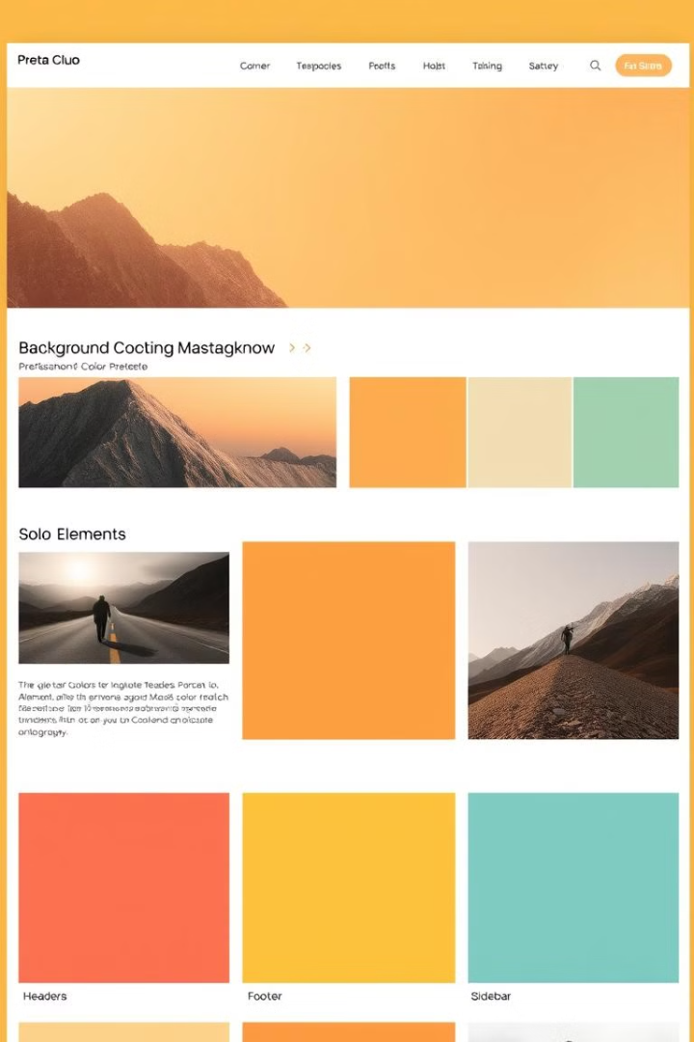



Applying background colors to elements
HTML Structure
The background color is applied to the HTML element using a class attribute. For example, to apply the bg-primary class to a div element, you'd use: <div class="bg-primary">Content</div>
CSS
The background color classes are defined in Foundation's CSS files, ensuring consistency and ease of use.
JavaScript
You can dynamically change background colors using JavaScript, allowing for interactive and responsive design elements.
Notes:
6

Slide 7




Accessibility considerations for background colors
Color Contrast
Ensure sufficient color contrast between text and background colors for users with visual impairments.
Color Blindness
Choose colors that are easily distinguishable by people with color blindness.
Alternative Text
Provide alternative text for images or other visual content that relies on color for its meaning.
Notes:
7

Slide 8

Best practices for using background colors
1
Color Palette
Stick to a limited color palette for a cohesive and polished look.
2
Visual Hierarchy
Use background colors to guide the user's eye and emphasize important content.
3
Readability
Prioritize readability by ensuring sufficient color contrast between text and background.
4
Responsiveness
Ensure background colors are responsive and adapt appropriately to different screen sizes.
Notes:
8

Slide 9



Responsive design and background colors
Large Screens
Medium Screens
Small Screens
Background colors can be more prominent and used to create distinct visual sections.
Background colors should be adjusted to ensure readability and maintain visual hierarchy.
Background colors should be simplified and used sparingly to avoid overwhelming the user.
Notes:
9

Slide 10

Conclusion and key takeaways
Background colors are an essential aspect of web design. They contribute to visual appeal, readability, and accessibility. By utilizing Foundation's utility classes and best practices, you can effectively implement background colors for a more engaging and user-friendly website experience.
Notes:
10

